Slide 1

Lecture 16: ATM Case Study

Slide 2
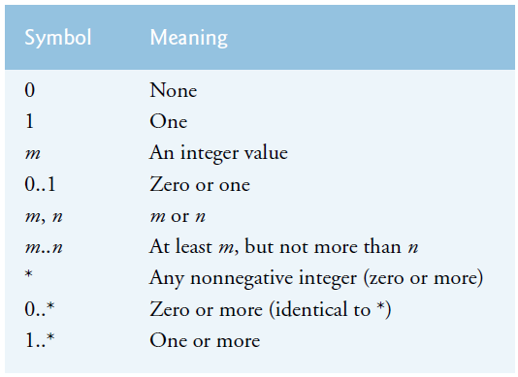

Revision: Association
One-way Association
0..1
1
House
Ali
0..1
1..x
House
Ali
Two-way Association: Person may subscribe many magazine. And a magazine can be subscribed by many person.

Slide 3
Introduction to analysis and design
For any problem, we do not simply write a code
We first analyze the project requirements
The process in object-oriented point of view in known as OOAD
It saves time, money, effort and avoids an ill-planned system development approach
For a small code, we may write a pseudocode before C++ coding
We use UML diagrams for our analysis representation

Slide 4
Phases of Analysis and Design
Some of the main phases of the system analysis and design are as follows;
Phase # 1: Understand the system requirement from “Requirements Document”
Phase # 2: Create Use Case Diagram for capturing the capabilities of the system
Phase # 3: Identify classes (nouns)
Phase # 4: Create Relationships (UML showing aggregation, association and composition)
Phase # 5: Identify the attributes (descriptive word or phrases)
Phase # 6: Identify functions (Verbs), then making parameters
Phase # 7: Create visibility
Phase # 8: Create Navigation
Phase # 9: Create inheritance and polymorphism
Phase # 10: Final Design

Slide 5
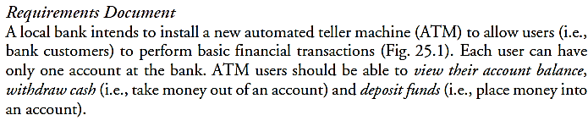
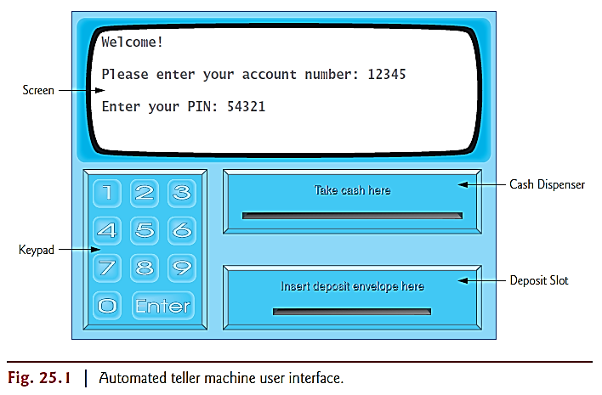
Automated Teller Machine (ATM): Understand the system requirement

Slide 6
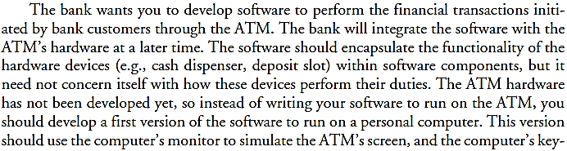
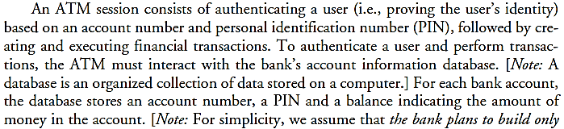

Slide 7
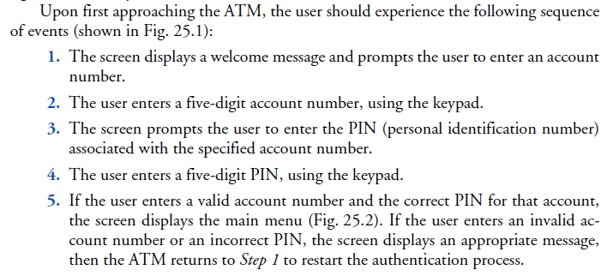

Slide 8
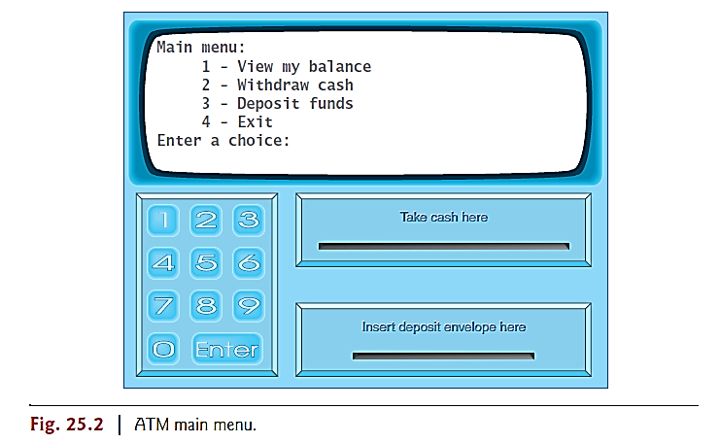
Menu After authentication
View balance

Slide 9
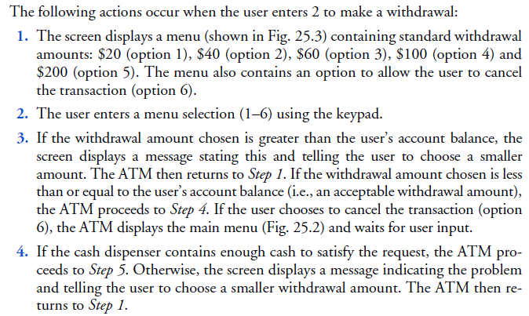
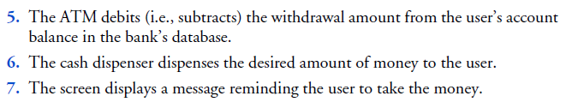
Withdrawal
Menu

Slide 10
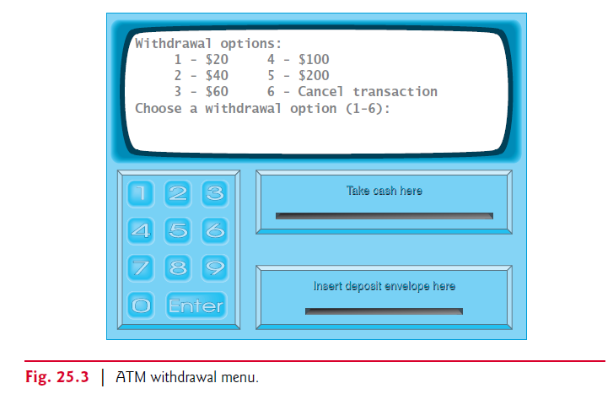
When user selects option 2 for withdrawal

Slide 11
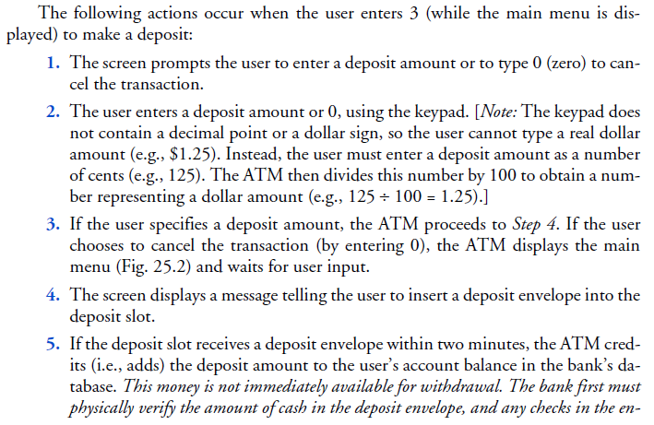
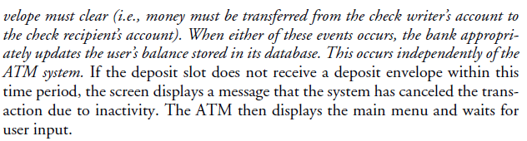
Deposit amount

Slide 12
Analyze the ATM system
Requirements gathering is the first stage of software design life cycle
Gather requirements by interview user and field specialist, financial experts etc.
The stages are:
Analysis, design, implementation, testing and debugging, deployment, maintenance, retirement
Use case modeling
Use cases helps us in capturing the capabilities of the system

Slide 13
Phases of Analysis and Design
Some of the main phases of the system analysis and design are as follows;
Phase # 1: Understand the system requirement from “Requirements Document”
Phase # 2: Create Use Case Diagram for capturing the capabilities of the system
Phase # 3: Identify classes (nouns)
Phase # 4: Create Relationships (UML showing aggregation, association and composition)
Phase # 5: Identify the attributes (descriptive word or phrases)
Phase # 6: Identify functions (Verbs), then making parameters
Phase # 7: Create visibility (attributes and functions)
Phase # 8: Create Navigation
Phase # 9: Create inheritance and polymorphism
Phase # 10: Final Design

Slide 14
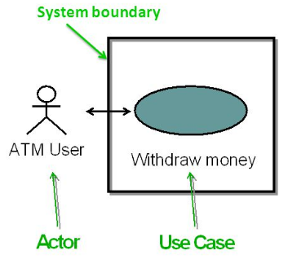
Use case diagram
Use cases define interactions between external actors and the system to attain particular goals.
Different capability system provide to user
Each use case defines typical scenario in which user uses system.
There are three basic elements that make up a use case:
Actors: Actors are the type of users that interact with the system.
System: Use cases capture functional requirements that specify the intended behavior of the system.
Goals: Use cases are typically initiated by a user to fulfill goals describing the activities and variants involved in attaining the goal.
Notes:
Use case: http://slideplayer.com/slide/8077060/

Slide 15
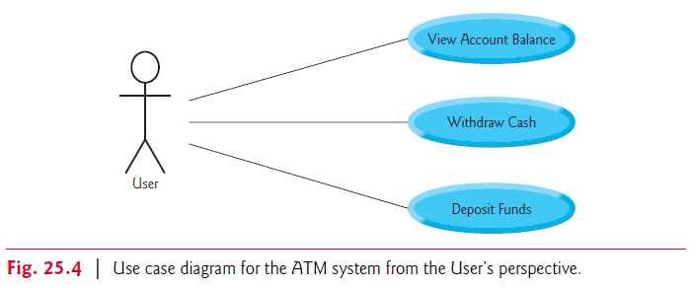
Use case diagram for capturing the capabilities of the system

Slide 16
Phases of Analysis and Design
Some of the main phases of the system analysis and design are as follows;
Phase # 1: Understand the system requirement from “Requirements Document”
Phase # 2: Create Use Case Diagram for capturing the capabilities of the system
Phase # 3: Identify classes (nouns)
Phase # 4: Create Relationships (UML showing aggregation, association and composition)
Phase # 5: Identify the attributes (descriptive word or phrases)
Phase # 6: Identify functions (Verbs), then making parameters
Phase # 7: Create visibility (attributes and functions)
Phase # 8: Create Navigation
Phase # 9: Create inheritance and polymorphism
Phase # 10: Final Design

Slide 17
Identifying the classes in a system
Finalize Classes
ATM
Screen
Keypad
Bank database
Cash dispenser
Balance Inquiry
Withdrawal
Account Deposit slot Deposit
Search for nouns and noun phrases
Nouns
Bank | Money/fund | Account number | ATM
Screen | PIN | User | Keypad
Bank database | Customer | Cash dispenser | Balance inquiry
Transaction | 20 $ Bill/cash | Withdrawal | Account
Deposit slot | Deposit | Balance | Deposit Envelope

Slide 18
Phases of Analysis and Design
Some of the main phases of the system analysis and design are as follows;
Phase # 1: Understand the system requirement from “Requirements Document”
Phase # 2: Create Use Case Diagram for capturing the capabilities of the system
Phase # 3: Identify classes (nouns)
Phase # 4: Create Relationships (UML showing aggregation, association and composition)
Phase # 5: Identify the attributes (descriptive word or phrases)
Phase # 6: Identify functions (Verbs), then making parameters
Phase # 7: Create visibility (attributes and functions)
Phase # 8: Create Navigation
Phase # 9: Create inheritance and polymorphism
Phase # 10: Final Design

Slide 19
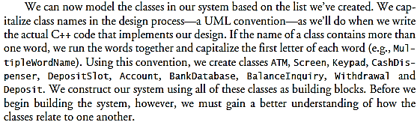
UML Conventions

Slide 20
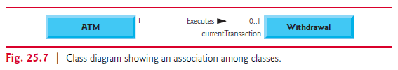
UML
Role
Name of association

Slide 21
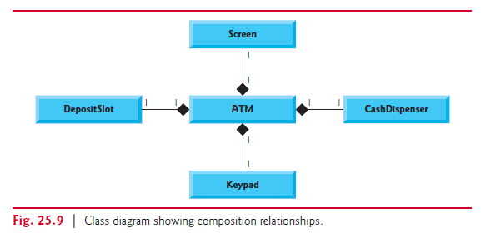
Composition
Diamond is only one sided.
Whole is responsible for creating and destroying its parts
A part may belong to one whole at a time.
If any of above condition is false then it’s a aggregation
Important:
Has a relationship : is composition
Is a relationship : inheritance

Slide 22
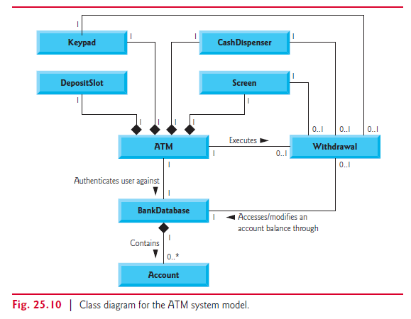
Class Diagram of ATM
Note:
Class balance inquiry and deposit participate in association in similar way as withdrawal. Omitted for simplicity

Slide 23
Phases of Analysis and Design
Some of the main phases of the system analysis and design are as follows;
Phase # 1: Understand the system requirement from “Requirements Document”
Phase # 2: Create Use Case Diagram for capturing the capabilities of the system
Phase # 3: Identify classes (nouns)
Phase # 4: Create Relationships (UML showing aggregation, association and composition)
Phase # 5: Identify the attributes (descriptive word or phrases)
Phase # 6: Identify functions (Verbs), then making parameters
Phase # 7: Create visibility (attributes and functions)
Phase # 8: Create Navigation
Phase # 9: Create inheritance and polymorphism
Phase # 10: Final Design

Slide 24
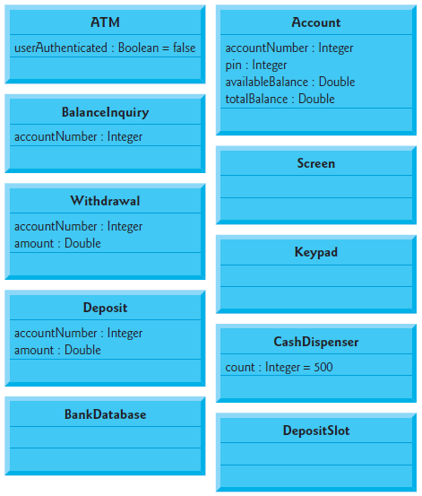
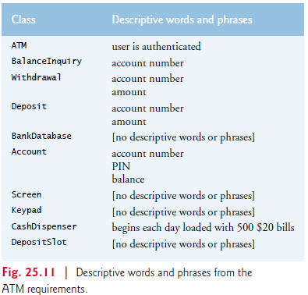
Identifying the class Attributes

Slide 25
Phases of Analysis and Design
Some of the main phases of the system analysis and design are as follows;
Phase # 1: Understand the system requirement from “Requirements Document”
Phase # 2: Create Use Case Diagram for capturing the capabilities of the system
Phase # 3: Identify classes (nouns)
Phase # 4: Create Relationships (UML showing aggregation, association and composition)
Phase # 5: Identify the attributes (descriptive word or phrases)
Phase # 6: Identify functions (Verbs), then making parameters
Phase # 7: Create visibility (attributes and functions)
Phase # 8: Create Navigation
Phase # 9: Create inheritance and polymorphism
Phase # 10: Final Design

Slide 26
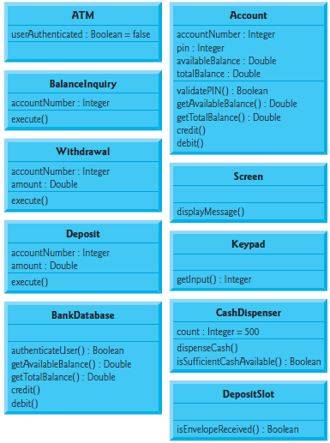
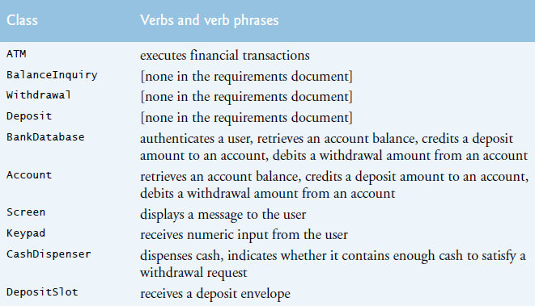
Identifying the class operations

Slide 27
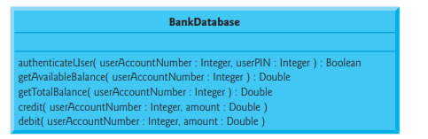
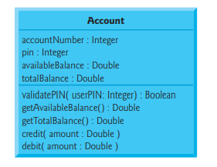
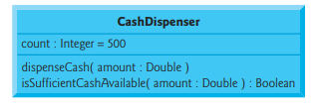

Identify and modeling of Operation parameters

Slide 28
Phases of Analysis and Design
Some of the main phases of the system analysis and design are as follows;
Phase # 1: Understand the system requirement from “Requirements Document”
Phase # 2: Create Use Case Diagram for capturing the capabilities of the system
Phase # 3: Identify classes (nouns)
Phase # 4: Create Relationships (UML showing aggregation, association and composition)
Phase # 5: Identify the attributes (descriptive word or phrases)
Phase # 6: Identify functions (Verbs), then making parameters
Phase # 7: Create visibility (attributes and functions)
Phase # 8: Create Navigation
Phase # 9: Create inheritance and polymorphism
Phase # 10: Final Design

Slide 29
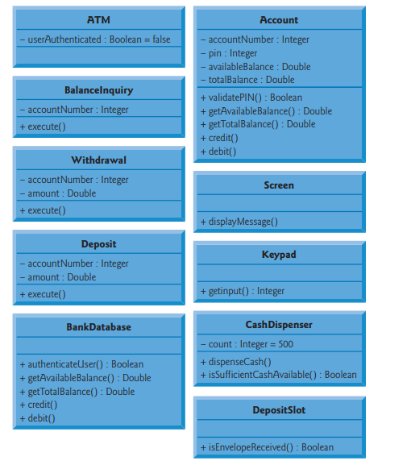
Visibility
Defining visibility of the attributes and functions
Public, private or protected

Slide 30
Phases of Analysis and Design
Some of the main phases of the system analysis and design are as follows;
Phase # 1: Understand the system requirement from “Requirements Document”
Phase # 2: Create Use Case Diagram for capturing the capabilities of the system
Phase # 3: Identify classes (nouns)
Phase # 4: Create Relationships (UML showing aggregation, association and composition)
Phase # 5: Identify the attributes (descriptive word or phrases)
Phase # 6: Identify functions (Verbs), then making parameters
Phase # 7: Create visibility (attributes and functions)
Phase # 8: Create Navigation
Phase # 9: Create inheritance and polymorphism
Phase # 10: Final Design

Slide 31
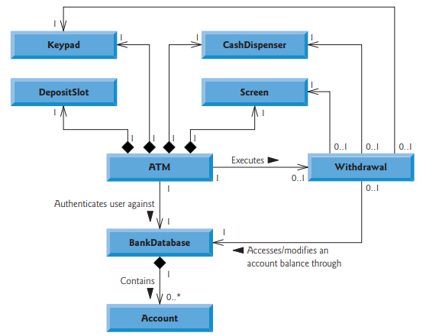
Navigations

Slide 32
Phases of Analysis and Design
Some of the main phases of the system analysis and design are as follows;
Phase # 1: Understand the system requirement from “Requirements Document”
Phase # 2: Create Use Case Diagram for capturing the capabilities of the system
Phase # 3: Identify classes (nouns)
Phase # 4: Create Relationships (UML showing aggregation, association and composition)
Phase # 5: Identify the attributes (descriptive word or phrases)
Phase # 6: Identify functions (Verbs), then making parameters
Phase # 7: Create visibility (attributes and functions)
Phase # 8: Create Navigation
Phase # 9: Create inheritance and polymorphism
Phase # 10: Final Design

Slide 33
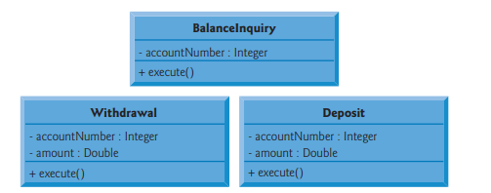
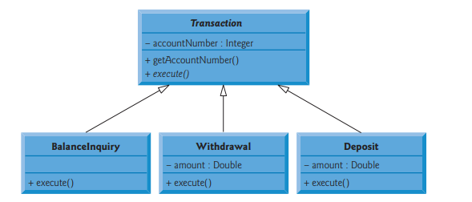
Accommodate Inheritance
See Common features in classes

Slide 34
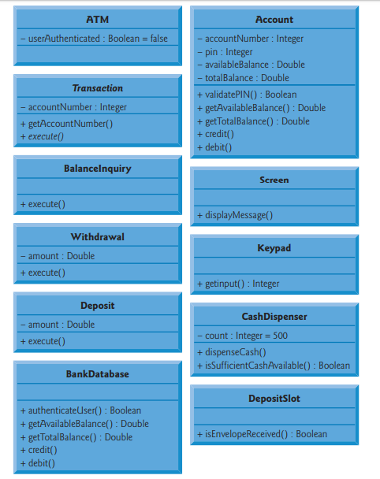
Inheritance Accommodation

Slide 35
Phases of Analysis and Design
Some of the main phases of the system analysis and design are as follows;
Phase # 1: Understand the system requirement from “Requirements Document”
Phase # 2: Create Use Case Diagram for capturing the capabilities of the system
Phase # 3: Identify classes (nouns)
Phase # 4: Create Relationships (UML showing aggregation, association and composition)
Phase # 5: Identify the attributes (descriptive word or phrases)
Phase # 6: Identify functions (Verbs), then making parameters
Phase # 7: Create visibility (attributes and functions)
Phase # 8: Create Navigation
Phase # 9: Create inheritance and polymorphism
Phase # 10: Final Design

Slide 36
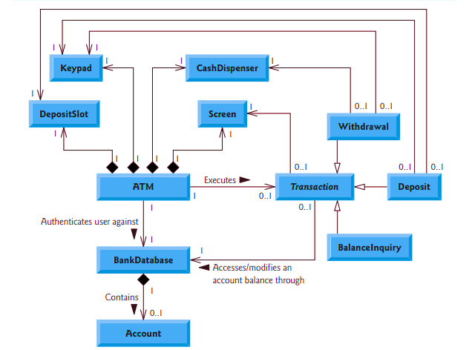
Final Design
Italic word shows the abstract classes

Slide 37
Reference
ATM Case Study Part 1 and Part 2 from book C++ how to program by deitel and deitel book

